Slide 1
Fitness Portal
Made By : Nachiket More
Karan Pagare
Vipul Gupta

Slide 2
MyNutrition
The Portal That Helps You to Achieve Your Fitness Goals.
www.MyNutrition.000webhostapp.com

Slide 3

The BMI Calculator with the Calories chart of Indian Foods Lets You Create Perfect Diet Plan !

Slide 4
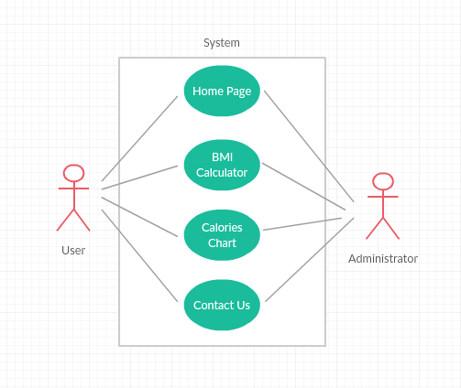
user case diagram

Slide 5
Use case diagram explanation -
use case diagram for fitness portal contains Home page Giving Information about the Portal followed by the BMI Calculator can calculate Body Mass Index of the user by knowing weight and height. The Count of Calories is also available to user.
The User gets to send feedback about portal to the developers through the Contact Us Page.

Slide 6
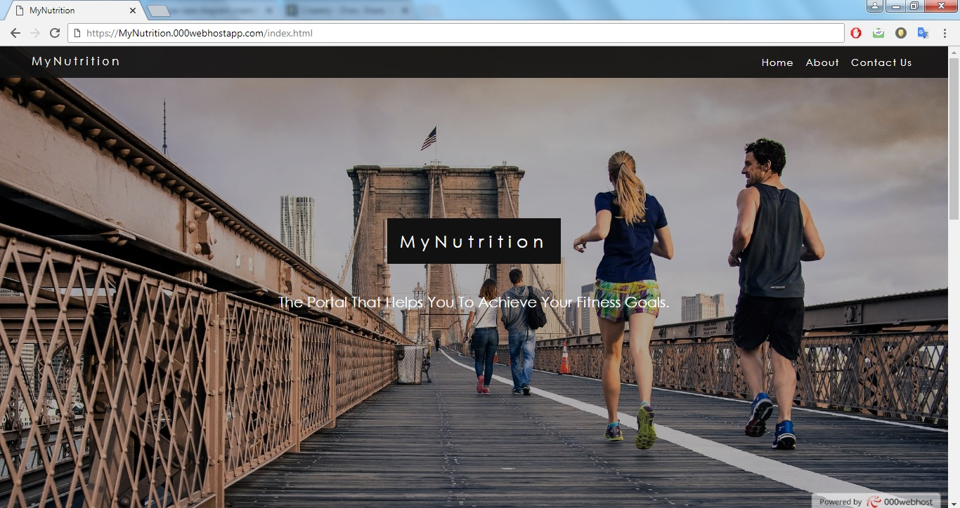
Home Page

Slide 7
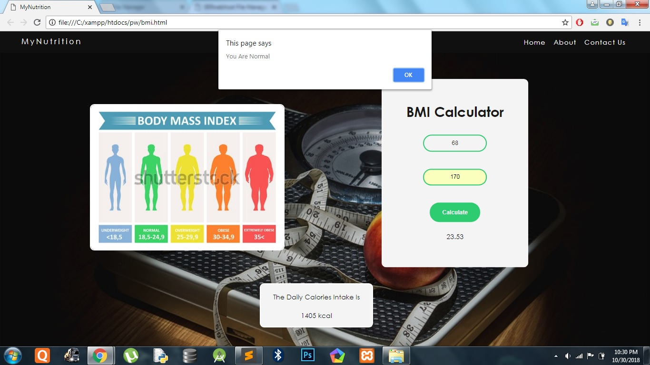
BMI Calculator

Slide 8
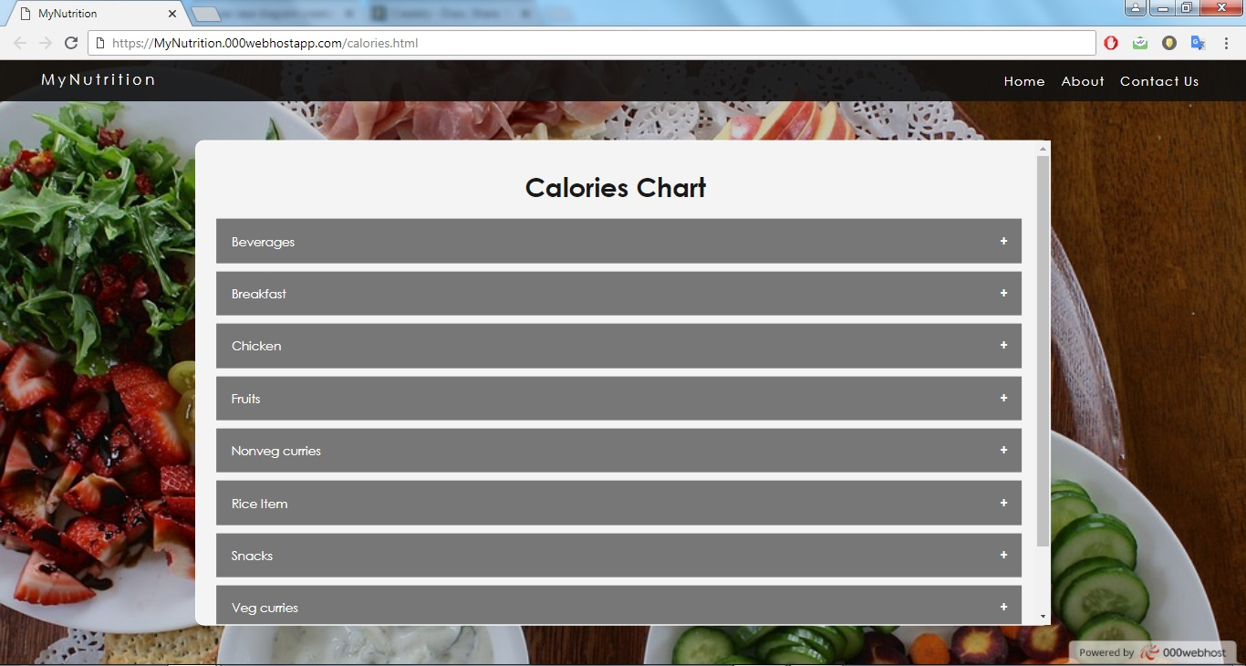
Calories Chart

Slide 9
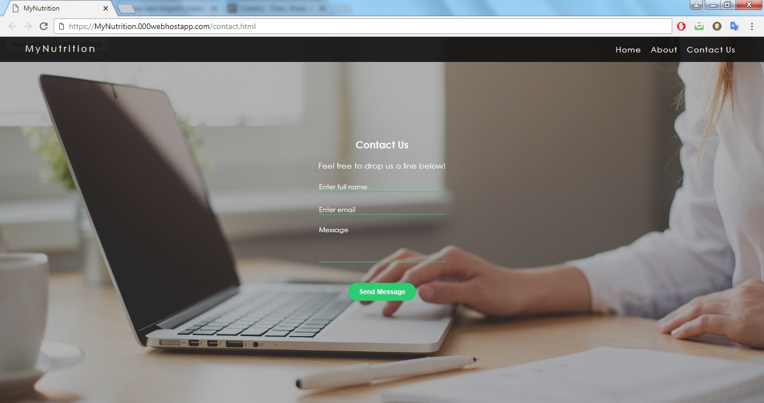
Contact Us

Slide 10
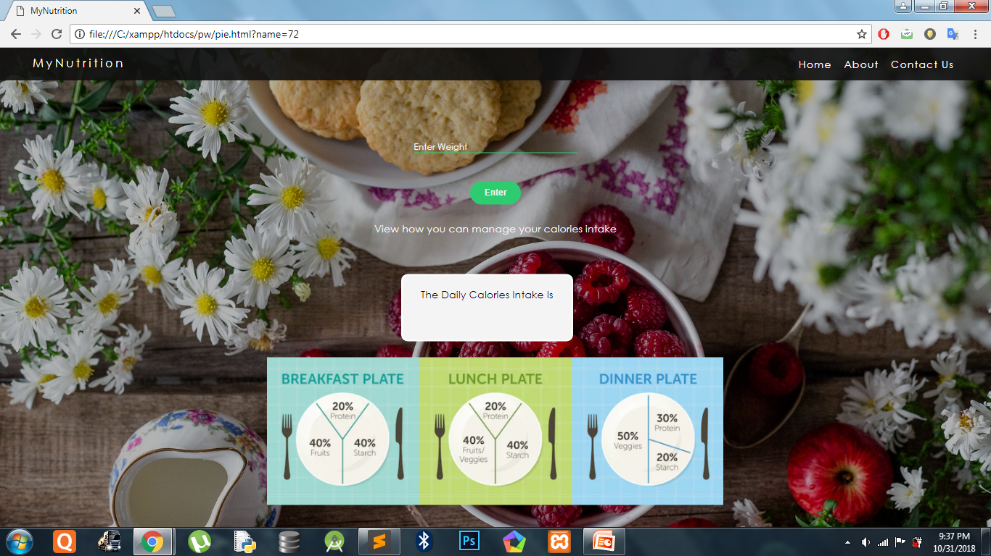
Calories Info

Slide 11
Technologies used and why ?
In this project we used CSS ,HTML5 , J Query , Java Script and PHP .
In which java script is used for animation .
CSS used for styles .
HTML5 is the latest version of Hypertext Markup Language, the code that describes web pages. It's actually three kinds of code: HTML, which provides the structure; Cascading Style Sheets (CSS), which take care of presentation; and JavaScript, which makes things happen.
And PHP is used for database connectivity

